Slide 1

模拟液体织物相互作用的多尺度模型
彭磊 21851067
指导老师：李启雷
Notes:
Hello. Let me start my talk with an event happened during my lunch.
So someday, I was enjoying my own lunch. But, the coffee was too hot and I didn’t notice that.

Slide 2
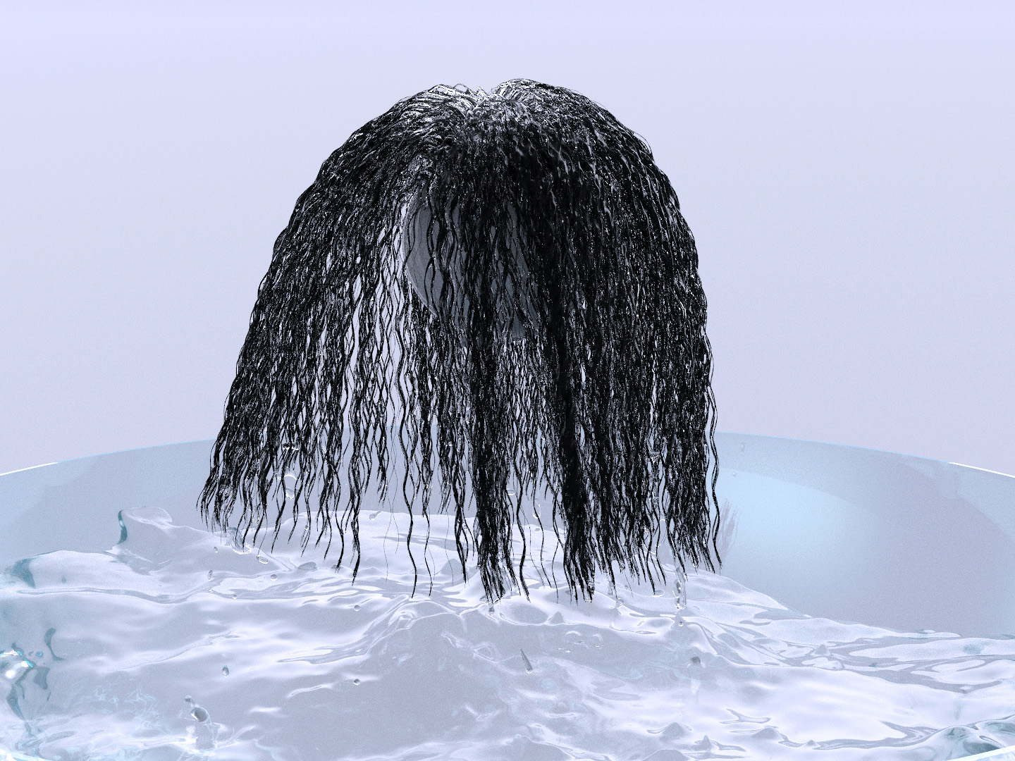
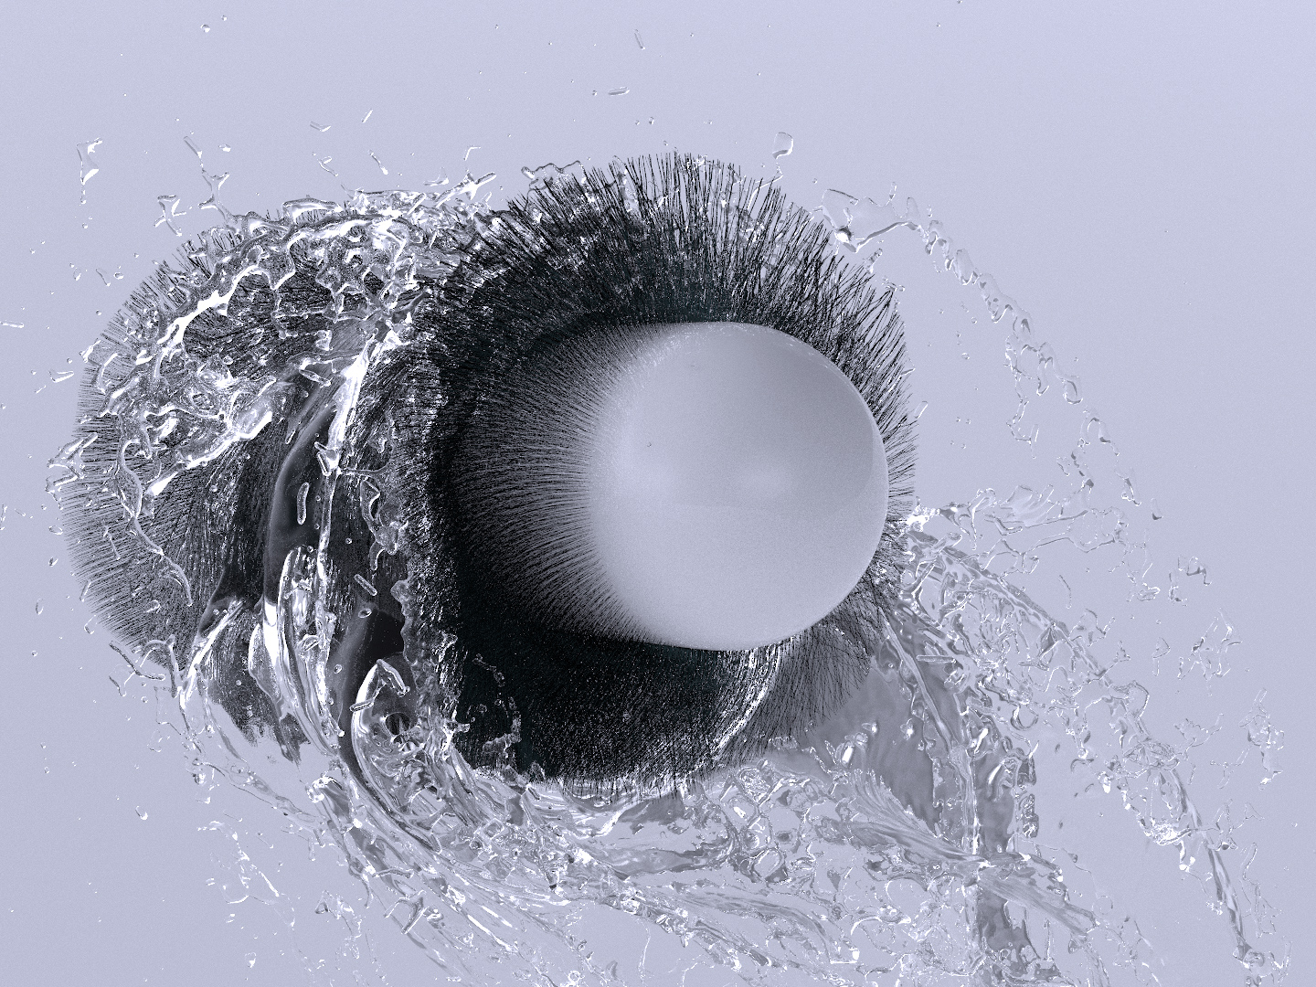
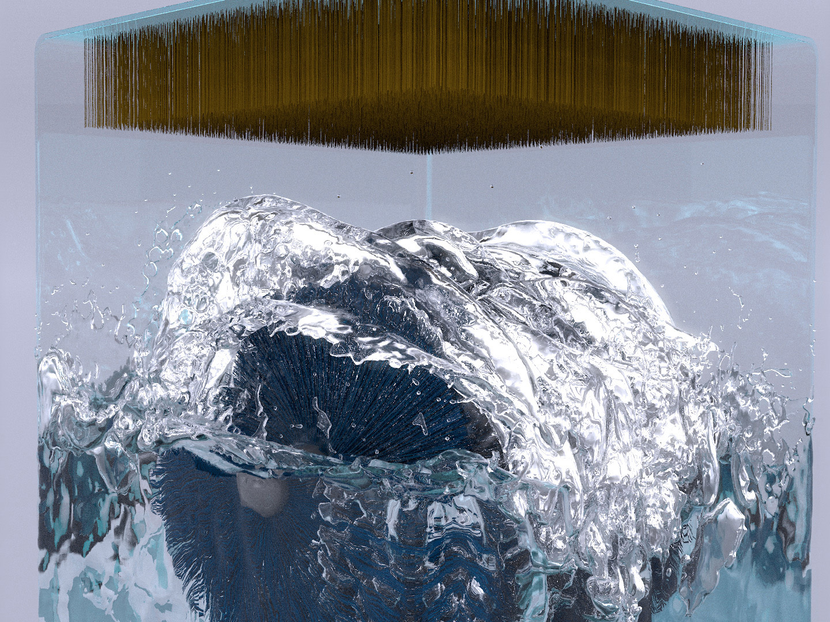
模拟液体织物相互作用的多尺度模型
Notes:
Last year we did wet hairs. But we don’t only want naked characters. Our characters should have clothes, right?
But wet clothes may have very different outlook than wet hairs.

Slide 3
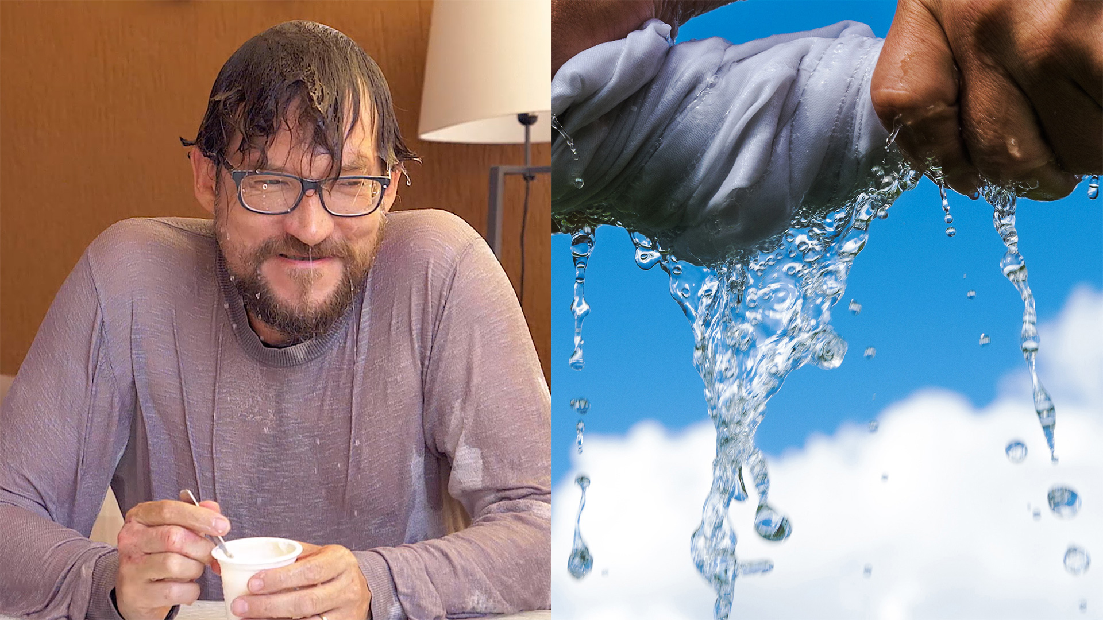
吸水
蔓延
滴水
Notes:
The liquid can get absorbed into the sheet of fabric. And the liquid may propagates through the fabric, and finally drips off from the fabric. So we need a different methods to handle liquid-fabric interactions.

Slide 4
液体织物相互作用的方法
双向耦合的原则性模型
湿织物的统一物理模型
一种高效的液织物混合物数值求解器
Notes:
Also previously, we didn’t derive the physics between liquid and solid, from the first principle.
So this year we want to work toward a principled model for two-way coupling.
Also, we want a unified physics that can handle various phenomena related to wet fabrics
Third, we need an efficient numerical solver.

Slide 5
作为连续介质的织物
Notes:
To explore this topic, let‘s begin with a continuum representation of fabrics.

Slide 6
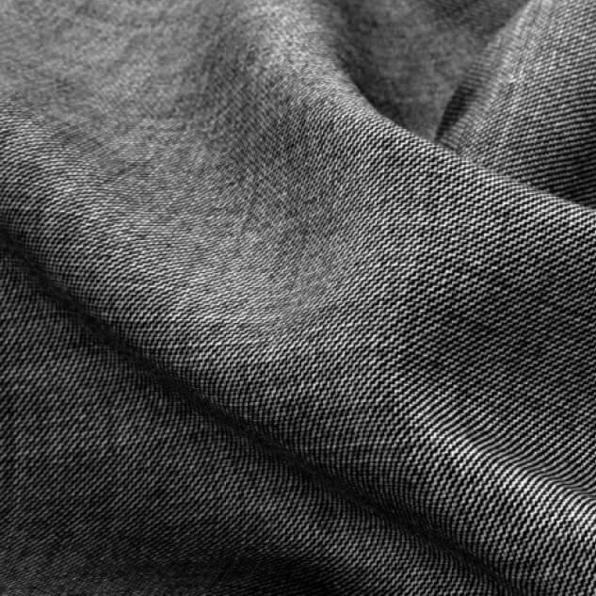
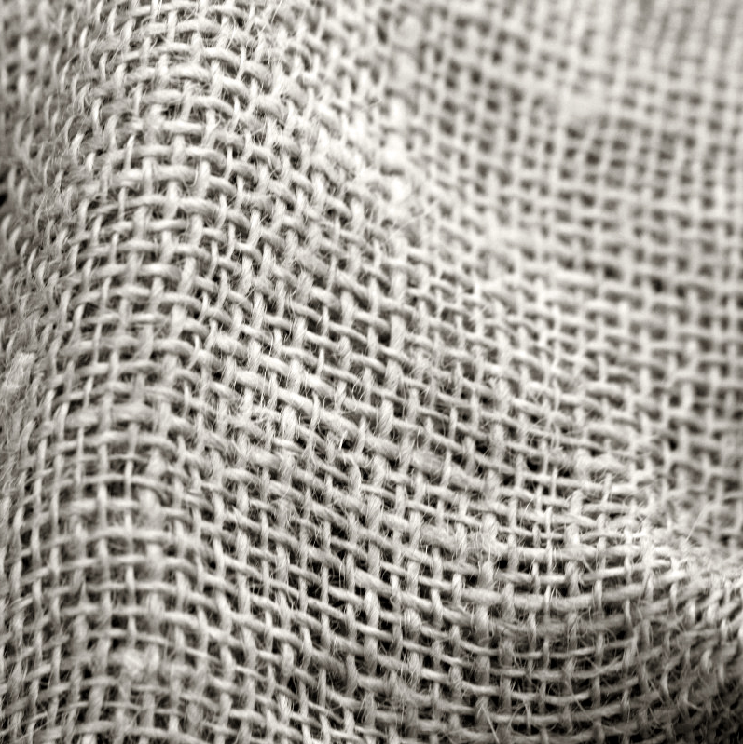
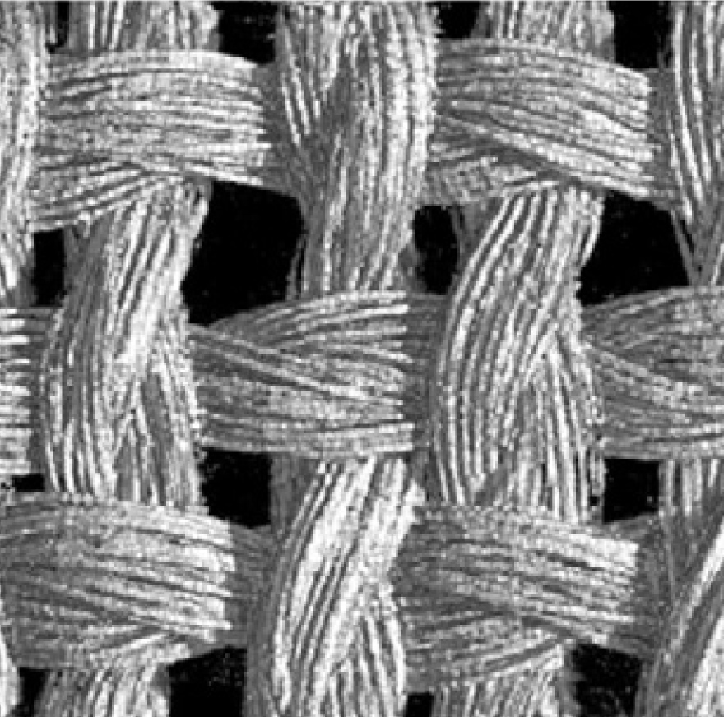
Notes:
Here’s a photo of woven fabrics.
If we put it under microscope, we may firstly see all the yarns.
And if zoom-in more closely, we may see the individual fibers.
So the entire fabric is composed of individual strands bundled into thin oriented fibers.

Slide 7
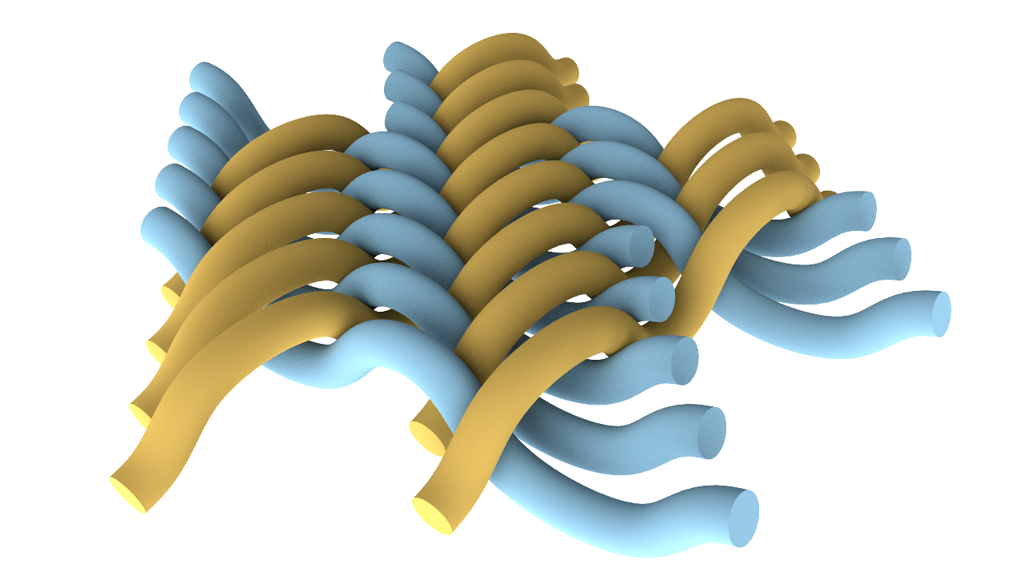
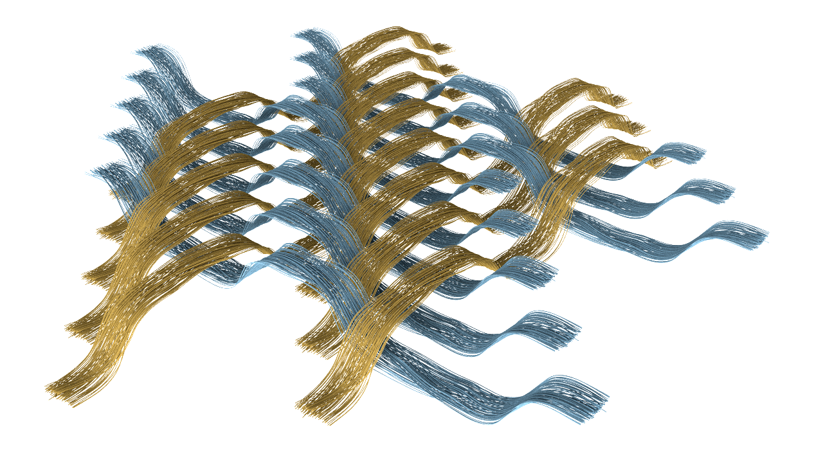
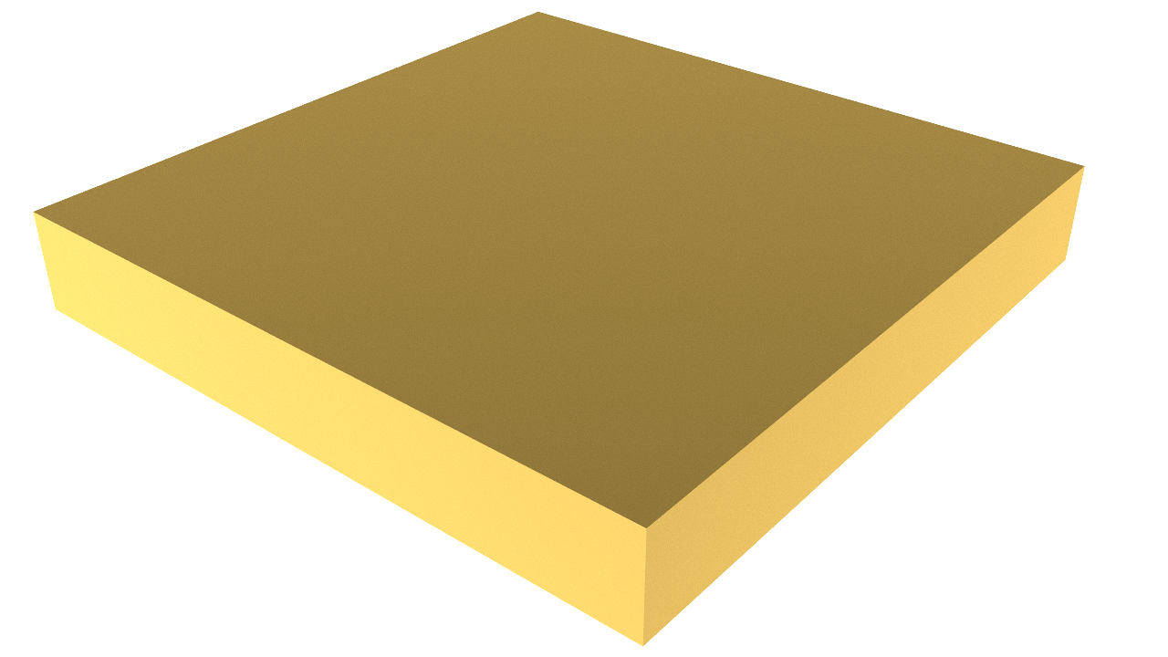
作为表面的织物模型
单纱线织物模型
单纤维织物模型
Notes:
In computer animation, varies fabric models have been proposed. For example, in large scale, we can model the fabric as a surface that has some thickness,
or if we want more details, we model the fabric as individual yarns.
Or if we really want to be hardcore we can model the individual fibers although it’s usually considered as intractable for animations.
But even with these geometries, how could we interacts them with liquid?
If we set these geometries as boundary conditions for the liquid, it would be too complicated for the yarns and fibers, and too thin to capture even just model the fabric as surface.

Slide 8
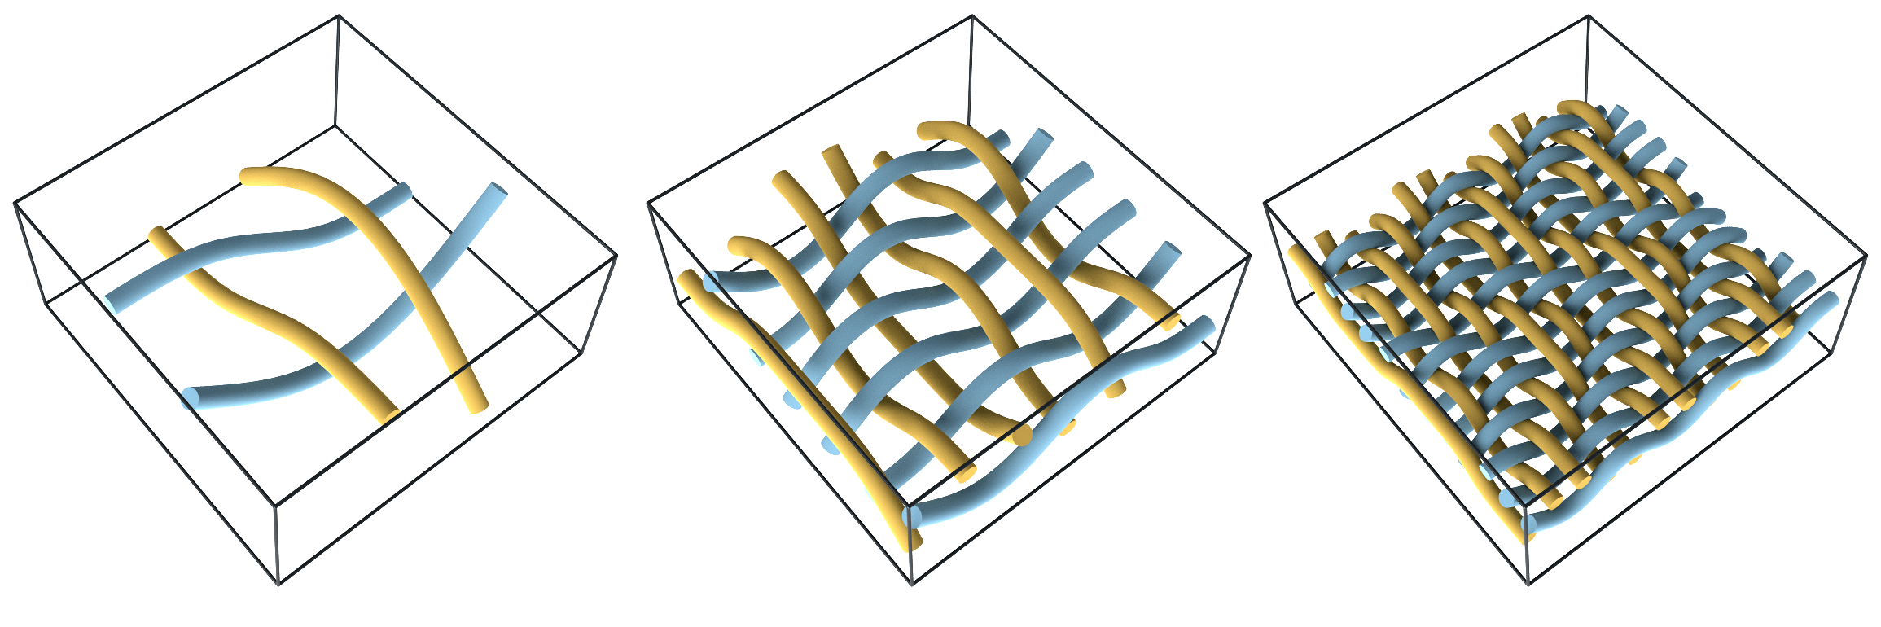
作为连续介质的织物模型
Higher Solid Volume Fraction $ϕ$
Lower Porosity $\left(1−ϕ\right)$
Notes:
The first pair of important concepts for porous media is volume fraction and porosity. Volume fraction means how much solid within a unit volume of porous media, and porosity is taken as the volume of liquid within this unit volume, as shown in the bottom left picture
Woltman firstly proposed this concept in the late 18th century, when he studied hydraulics for architecture. He said “Assuming the water-filled space between the loose earth, are to bulk volume as 𝑟:1, then the density of mud is capital P plus r times little p, where capital P is the density of earth and little p the density of water.”
Nowadays we call 𝑟 as the porosity, or amount of water filling the unit volume

Slide 9
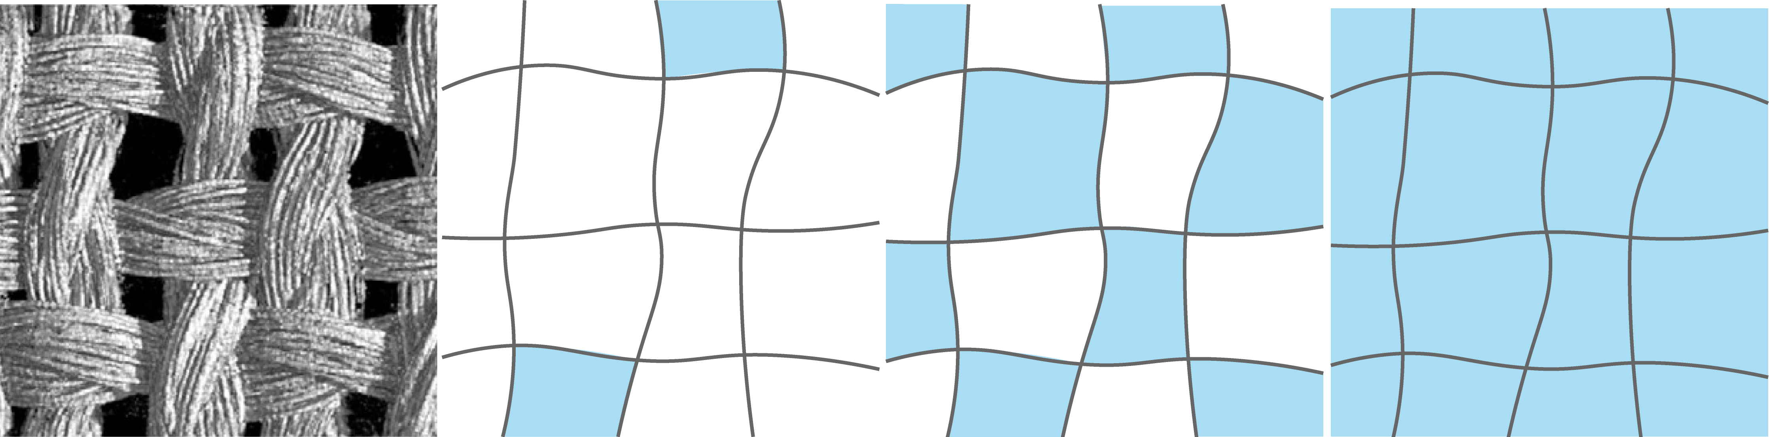
饱和度
低饱和度
高饱和度
Notes:
And when there’s fluid comes in, these tiny pockets inside and between these fibers may collect fluids and are largely responsible for the wetting behavior we observe at the coarse scale.

Slide 10
Solid Volume Fraction $ϕ$
Saturation $S_{r}$
Notes:
In summary, by modeling fabric as mixtures, instead of using boundary conditions, we can characterize different microstructure with several scaler field, such as the volume fraction or saturation

Slide 11
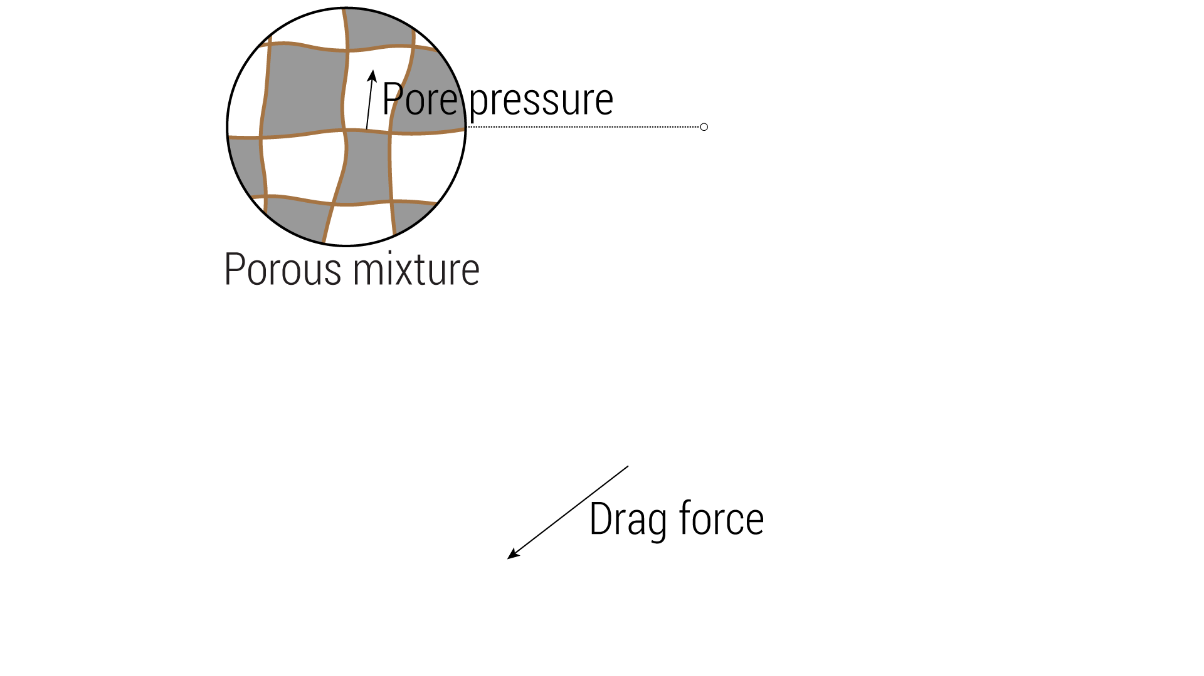
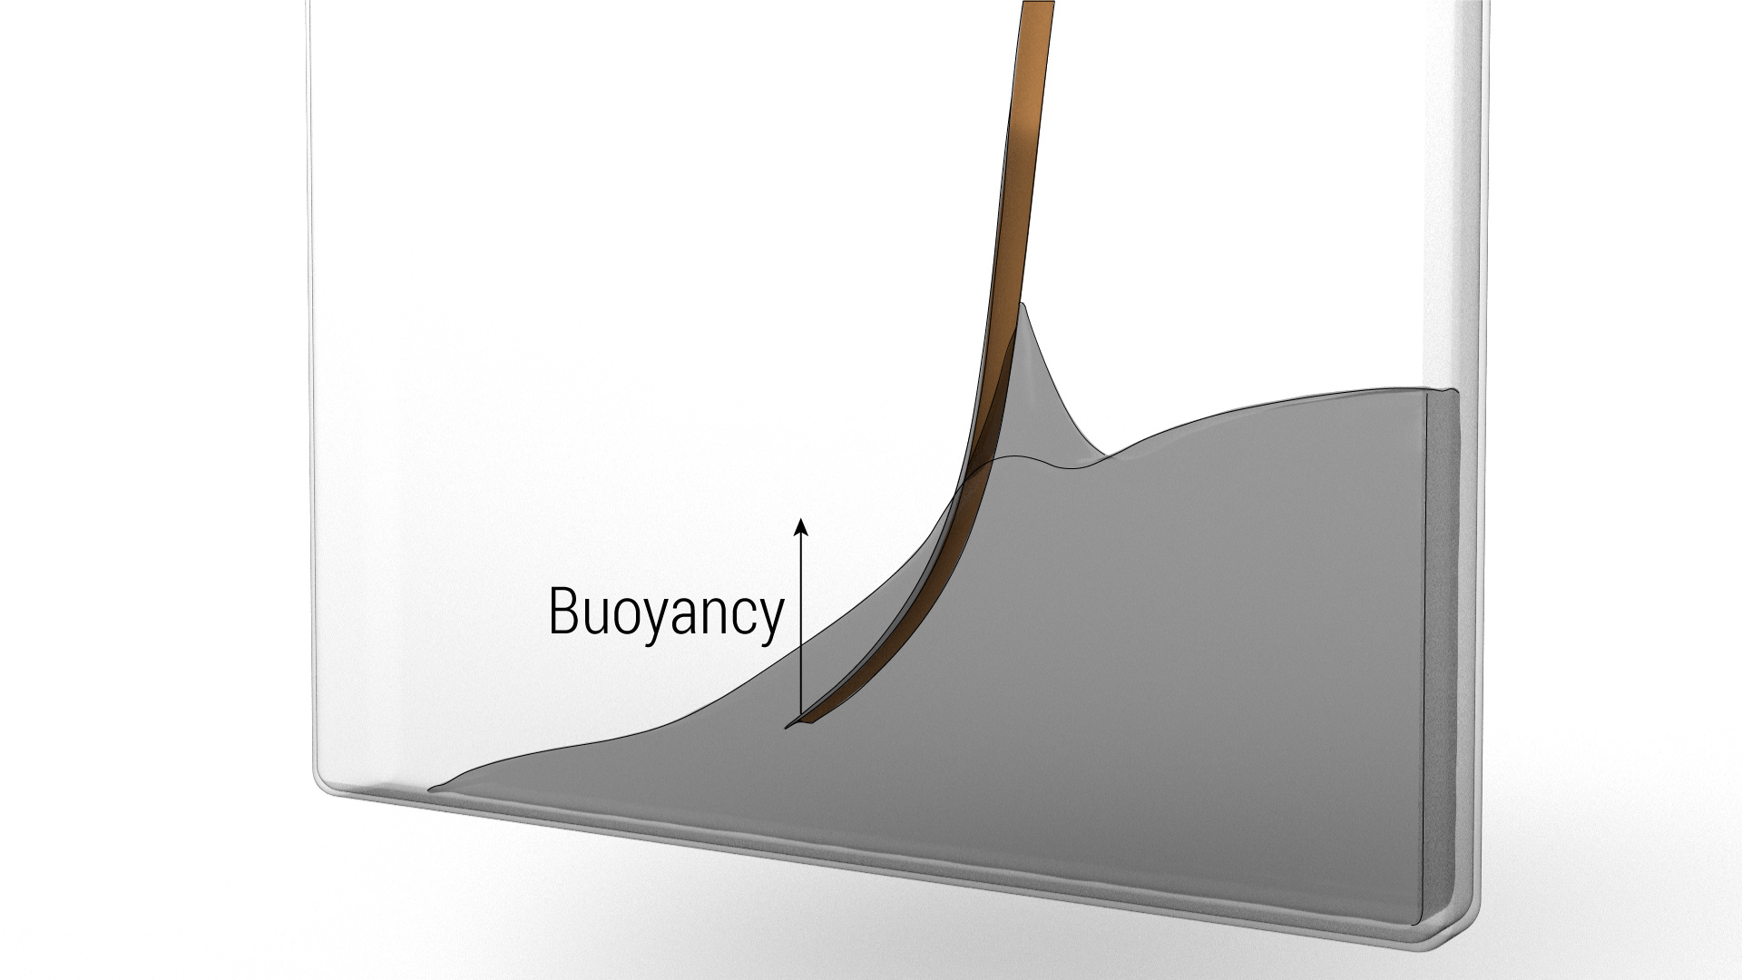

混合理论
混合理论对具有浮力的部分饱和织物的适应性
非线性阻力和孔隙压力的各向异性织物微观结构
Notes:
[Add title]
With such representation, we are able to handle fabrics with different mass density, by calculating the buoyancy for partially saturated porous media.
Besides buoyancy, we can calculate drag force and capillary pore pressure from the continuum representation, which have analytical forms that are defined on local microstructures.

Slide 12
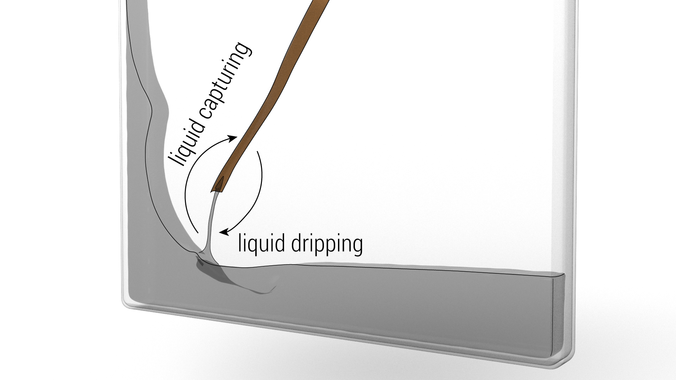
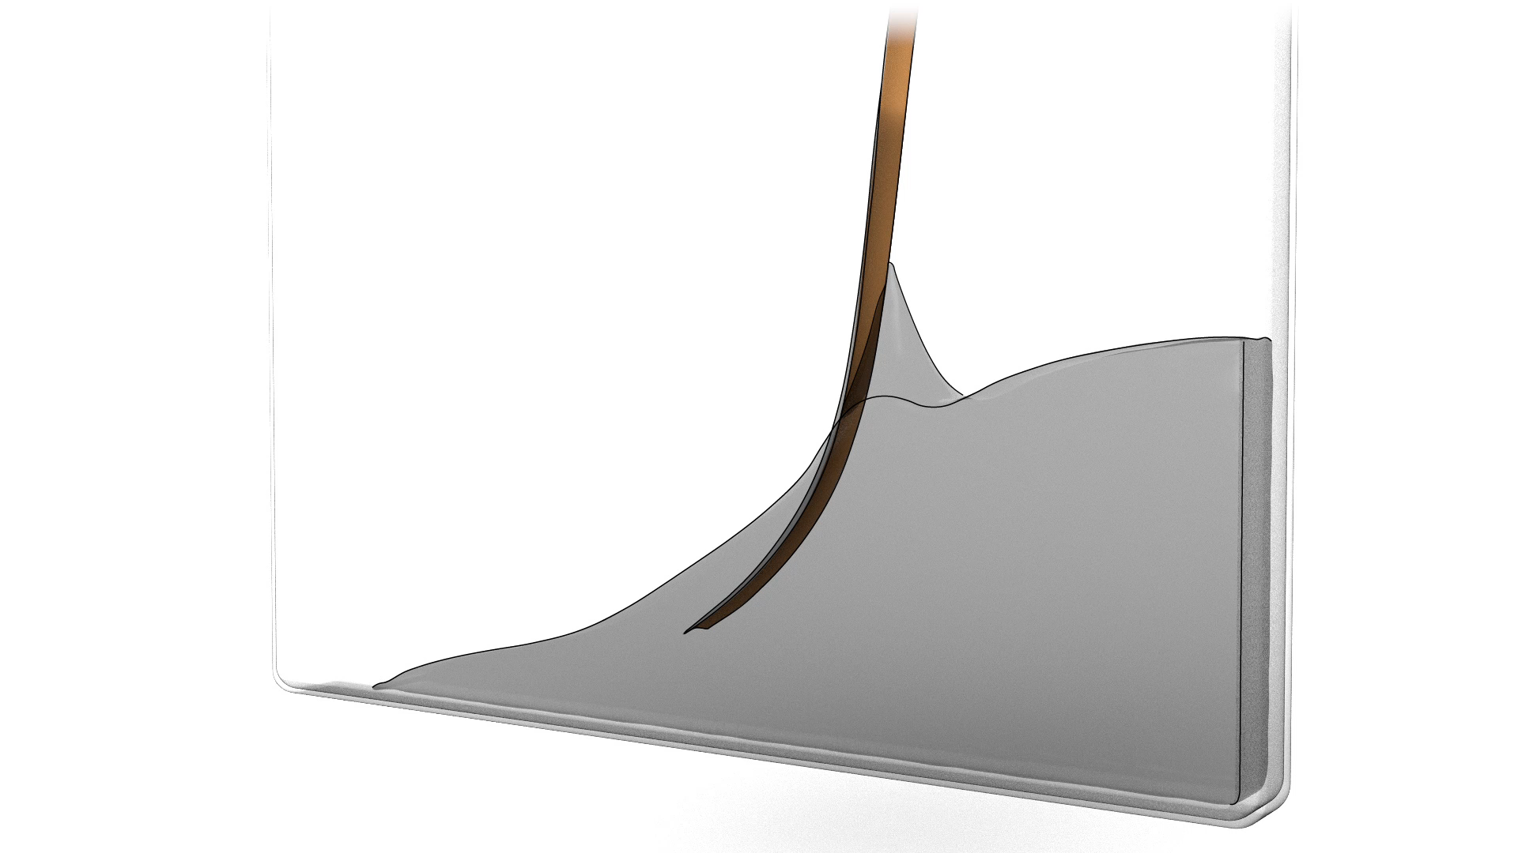
混合理论
混合理论对具有浮力的部分饱和织物的适应性
非线性阻力和孔隙压力的各向异性织物微观结构
液体捕获和滴液处理
织物内部流动的准静态模型
flow within the fabric
Notes:
When the cloth is submerged into liquid, the fabric will absorb liquid into its pores, and when the liquid detaches, it will drip from the cloth. These effects are treated with a continuum representation.
The liquid may also propagate on cloth, where we need the physics model for this flow inside the fabric. We show a quasi-static model that can be derived from the dynamic continuum model.

Slide 13
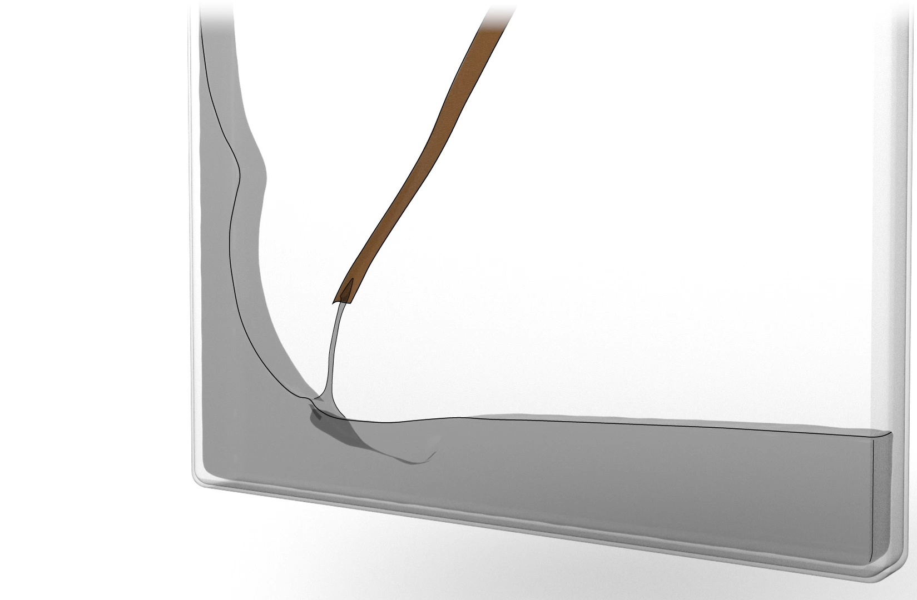
混合理论
混合理论对具有浮力的部分饱和织物的适应性
非线性阻力和孔隙压力的各向异性织物微观结构
液体捕获和滴液处理
织物内部流动的准静态模型
双向耦合液织物的有效分割模型
A unified physical model
An efficient numerical solver
Notes:
Finally, we implemented a splitting scheme to solve the equations.
So these contributions correspond to what we wanted: a unified, principled physics model for liquid-fabric mixture, and an efficient numerical solver.

